Slide 1


Preventing inadvertent survey respondent identification through disclosure avoidance review.
Michael Lotspeich-Yadao
mlots2@Illinois.edu
20250821

Slide 2
Mitigating disclosure risks ◯ ◯ ◯ ◯ ◯ ◯ ◯ | Addressing implicit samples ◯ ◯ | Key takeaways and workflow ◯ ◯ ◯ ◯
Heading
Today’s learning outcomes
Understand disclosure risk in survey data.
Identify potential disclosure risks in your research.
Use an automated program to check for disclosure risk.
Implement solutions when risks are identified.
Document your disclosure avoidance process.
Understand implicit samples and their risks.

Slide 3

Mitigating disclosure risks ⬤ ◯ ◯ ◯ ◯ ◯ ◯ | Addressing implicit samples ◯ ◯ | Key takeaways and workflow ◯ ◯ ◯ ◯
Mitigating disclosure risk
What is a disclosure risk?
A disclosure risk is anytime individual respondents can be identified in your data, even without their names or IDs.
You report: "1 Buddhist person over age 80 with a PhD in the sample."
If someone knows such a person exists in your sampling frame...
They might identify that specific individual.
This violates privacy and confidentiality promises.
Even aggregate statistics can reveal individual information!

Slide 4
Mitigating disclosure risks ◯ ⬤ ◯ ◯ ◯ ◯ ◯ | Addressing implicit samples ◯ ◯ | Key takeaways and workflow ◯ ◯ ◯ ◯
Mitigating disclosure risk
The triangle of risk
Small cell sizes (<3 or less observations)
Unique combinations (rare characteristics)
External knowledge (what others might know)
When all three elements combine, individuals become identifiable!

Slide 5
Mitigating disclosure risks ◯ ◯ ⬤ ◯ ◯ ◯ ◯ | Addressing implicit samples ◯ ◯ | Key takeaways and workflow ◯ ◯ ◯ ◯
Mitigating disclosure risk
Types of disclosure risk
Direct disclosure
Tables with cells containing 1-2 observations
Unique combinations of demographics
Indirect disclosure
Cross-referencing multiple tables
Combining released data with external information
Implicit sample disclosure
When subsamples reveal information about excluded groups
Example: If you report on the “employed” only, the “unemployed” becomes an implicit sample.

Slide 6
Mitigating disclosure risks ◯ ◯ ◯ ⬤ ◯ ◯ ◯ | Addressing implicit samples ◯ ◯ | Key takeaways and workflow ◯ ◯ ◯ ◯
Mitigating disclosure risk
We often use “three” as a common answer to protecting respondents.
Why use three?
Privacy rationale: With only 1-2 responses in a cell, it becomes easier to identify specific individuals, especially when combined with other publicly available information. Three provides a basic buffer against direct identification.
Statistical rationale: Very small cell counts are also unreliable statistically – they’re highly sensitive to individual responses and don’t represent meaningful patterns.

Slide 7
Mitigating disclosure risks ◯ ◯ ◯ ◯ ⬤ ◯ ◯ | Addressing implicit samples ◯ ◯ | Key takeaways and workflow ◯ ◯ ◯ ◯
Mitigating disclosure risk
What makes a good minimum threshold?
The “right” threshold depends on several, context-sensitive considerations:
Sensitivity of data: Health, income, or behavioral data might need thresholds of 5-10+
Population size: Smaller populations need higher thresholds
Geographic granularity: Neighborhood-level data would need higher suppression than state-level.
Other available variables: Greater demographic breakdowns introduces a greater level of risk.

Slide 8
Mitigating disclosure risks ◯ ◯ ◯ ◯ ◯ ⬤ ◯ | Addressing implicit samples ◯ ◯ | Key takeaways and workflow ◯ ◯ ◯ ◯
Mitigating disclosure risk
Additional protection measures for survey respondents.
Rather than relying solely on a threshold, consider:
Complementary suppression: If you suppress one cell, additional cells should also be suppressed to prevent the calculation of the hidden value.
Rounding: Consider rounding all counts to the nearest 5, 10, 50, 100…
Top/bottom coding: For continuous variables, group extreme values.
Noise injection: Add controlled random variation to counts.
The key insight is that no single threshold is universally "correct" - it should be proportional to your disclosure risk.
A threshold of 5-10 is a more conservative standard, recognizing that three may be insufficient in our current data environment where multiple datasets can be linked together.

Slide 9
Mitigating disclosure risks ◯ ◯ ◯ ◯ ◯ ◯ ⬤ | Addressing implicit samples ◯ ◯ | Key takeaways and workflow ◯ ◯ ◯ ◯
Mitigating disclosure risk
disclosure_check ado for Stata
The purpose of this ado is to automatically check for disclosure risks in models in Stata.
disclosure_check varlist,
samplename(string)
threshold(#)
outputfile(filename.xlsx)
[detail] [replace]
Features
Checks cell counts automatically
Identifies suppression requirements
Exports results to Excel
Handles cross-tabulations with detail option

Slide 10
Mitigating disclosure risks ◯ ◯ ◯ ◯ ◯ ◯ ◯ | Addressing implicit samples ⬤ ◯ | Key takeaways and workflow ◯ ◯ ◯ ◯
Addressing implicit samples
What is an implicit sample?
The implicit sample is the non-religious respondents (N = 200).
All survey respondents are the main sample (N = 1000).
This is a disclosure risk!
If we identify the main sample and then identify a subset and give specifics about that subset (or even give the average for the whole and the subset), it’s possible to reconstruct the statistics for the implicit sample which is an inadvertent disclosure.
Respondents who identify as religious are the sub-sample (N = 800).

Slide 11
Mitigating disclosure risks ◯ ◯ ◯ ◯ ◯ ◯ ◯ | Addressing implicit samples ◯ ⬤ | Key takeaways and workflow ◯ ◯ ◯ ◯
Addressing implicit samples
check_implicit ado for Stata
The purpose of this ado is to identify and check implicit samples.
check_implicit,
sample1(main_sample)
sample2(subsample)
[varlist(variables_to_check)]
threshold(#)
Features
Calculates implicit sample size
Warns if below threshold
Checks variables within implicit sample
Returns pass/fail status

Slide 12
Mitigating disclosure risks ◯ ◯ ◯ ◯ ◯ ◯ ◯ | Addressing implicit samples ◯ ◯ | Key takeaways and workflow ⬤ ◯ ◯
Key takeaways and workflow
Workflow for disclosure avoidance
Define your analysis sample.
Run your analysis.
Check main sample.
Check subsamples
Document decisions
Create a sample indicator.
Generate results.
Use disclosure_check
Use disclosure_check on each
Check implicit samples
Use check_implicit
Address problems
Suppress/ collapse/ aggregate
Create audit trail
Export safe results
Release approved output.

Slide 13
Mitigating disclosure risks ◯ ◯ ◯ ◯ ◯ ◯ ◯ | Addressing implicit samples ◯ ◯ | Key takeaways and workflow ◯ ⬤ ◯
Key takeaways and workflow
What should I take away from today?
Disclosure risk is real, even when the data is aggregated.
Automated tools, like an ado script, can reduce errors and save time.
Don’t forget about implicit samples– they’re easily overlooked.
Document everything, creating a clear audit trail.
When in doubt, protect – err on the side of caution.

Slide 14
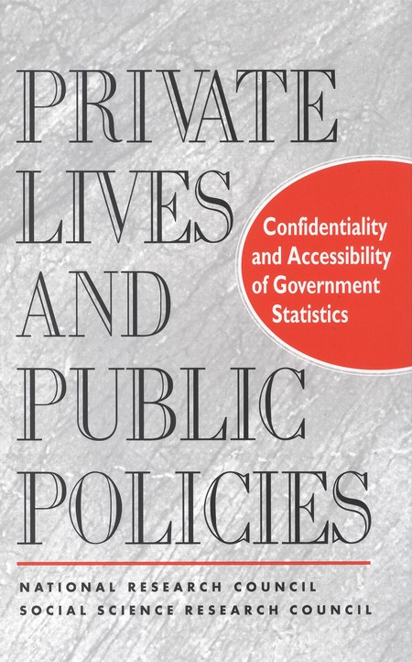
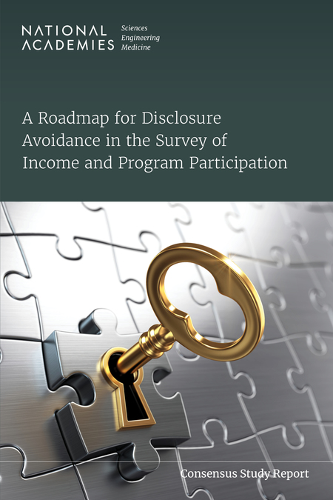

Mitigating disclosure risks ◯ ◯ ◯ ◯ ◯ ◯ ◯ | Addressing implicit samples ◯ ◯ | Key takeaways and workflow ◯ ◯ ⬤
Key takeaways and workflow
Interested in learning more? Look to the FSS and their agencies.

